Slide 1
ELyceum
Руденко Роман

Slide 2
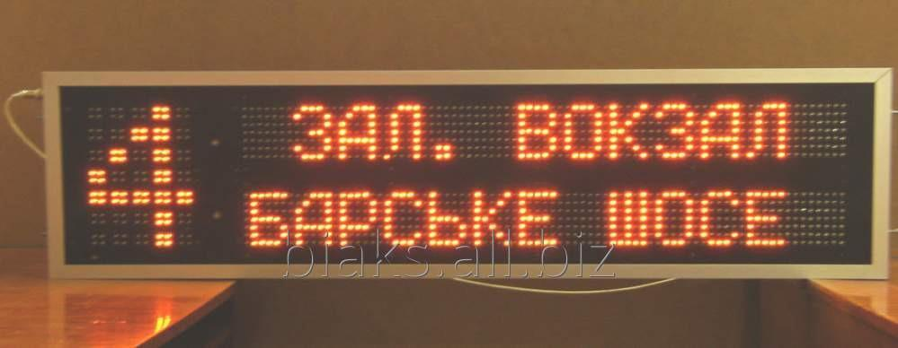

The main idea
My project is a running string, which includes a scanner. The main idea of my project is to combine Rfid module and matrix module, which you can set in different schools. For example, it will work in such way: after entering the school, you will see a screen with a running string and scanner below. If you put an electronic studying card, you will see a special information for you, for example a school timetable.

Slide 3
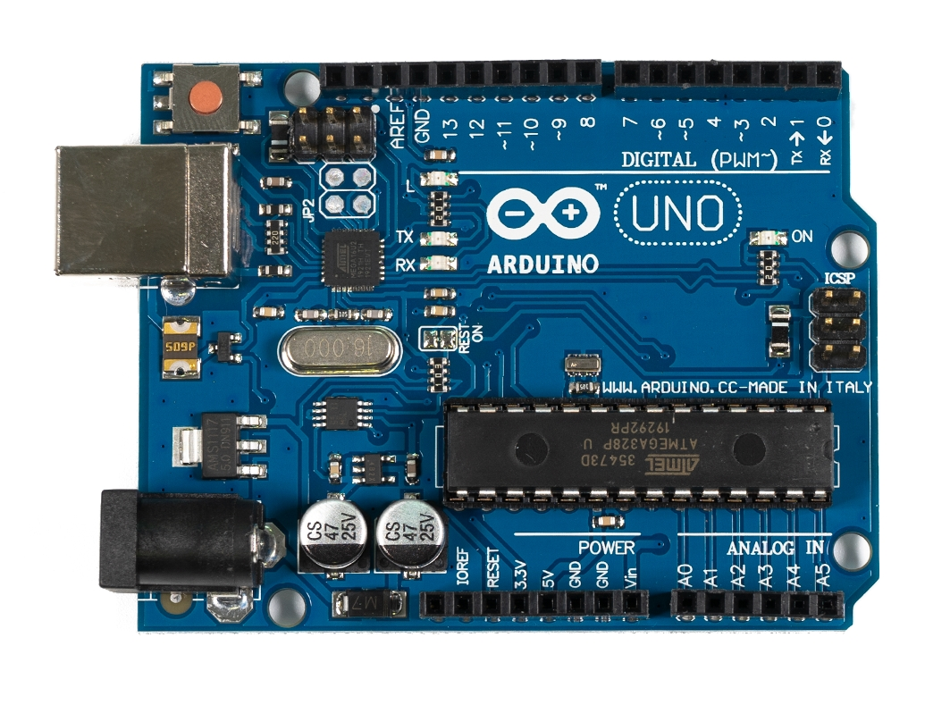
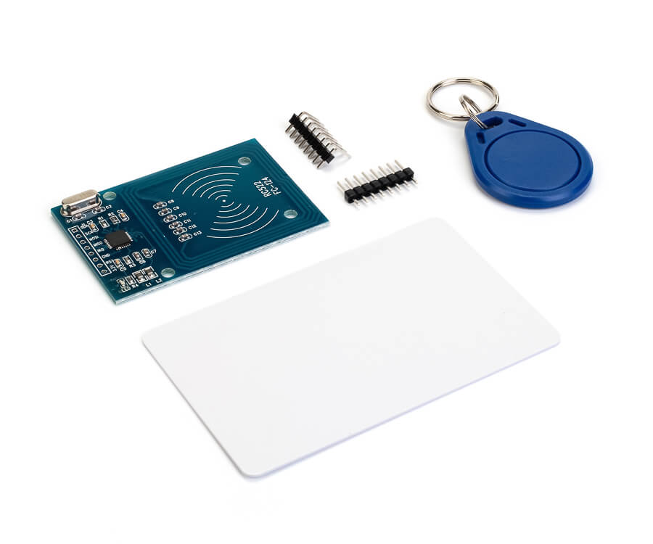
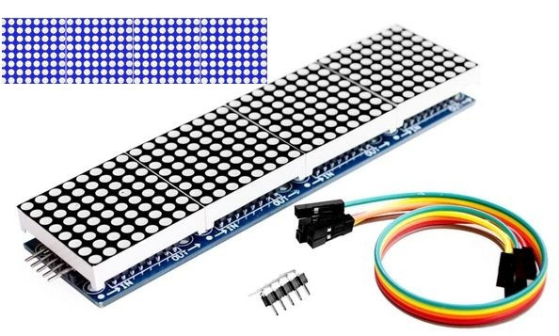
Project Includes
Main parts
Arduino Uno
Rfid module
Matrix module 8х32 MAX7219

Slide 4
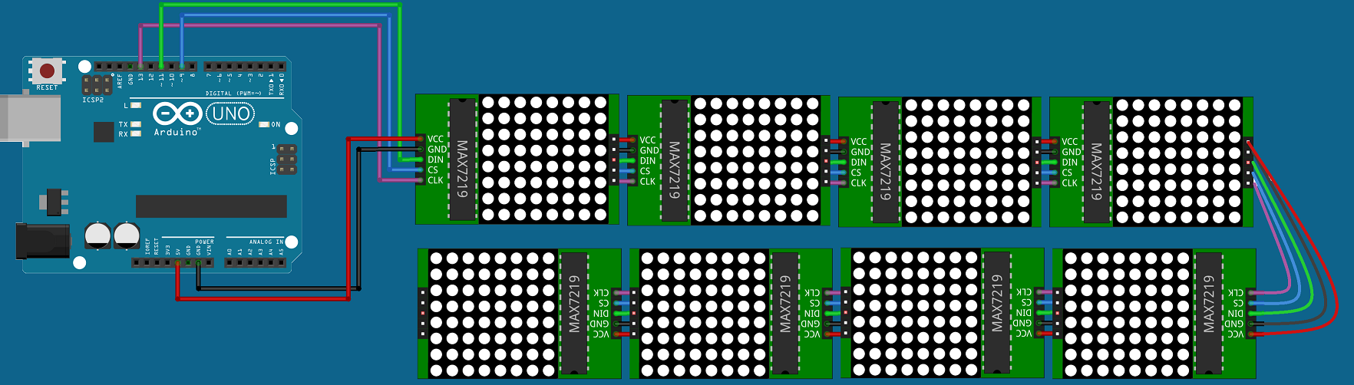
Project Includes
My project includes two parts. The first one is eight matrixes. They are connected in such way: VCC-5V; GND-GND; DIN-~11; CS-~9; CLK-13;

Slide 5
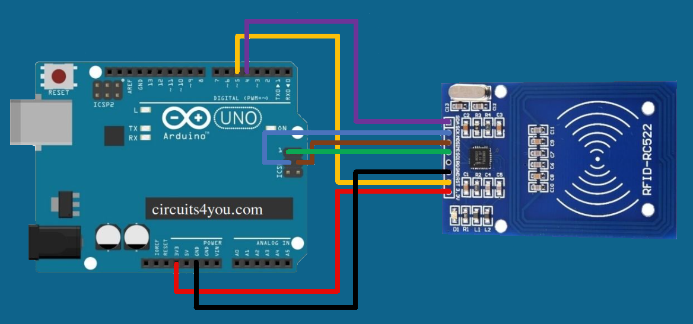
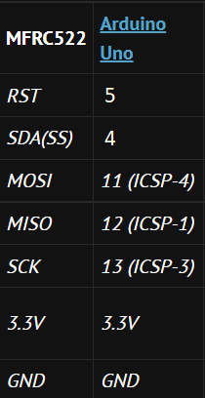
Project Includes
The second part is Rfid module. It is connected in such way : RST-5; SDA(SS)-4; MOSI-ISCP4; MISO-ISCP1; SCK3-ICSP3;

Slide 6
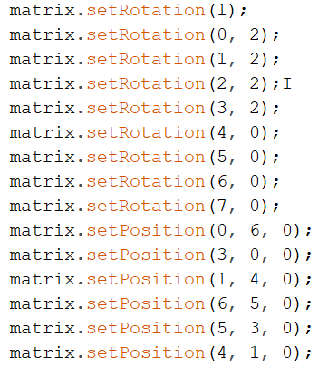
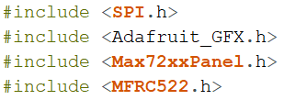
Code and code problems

Slide 7
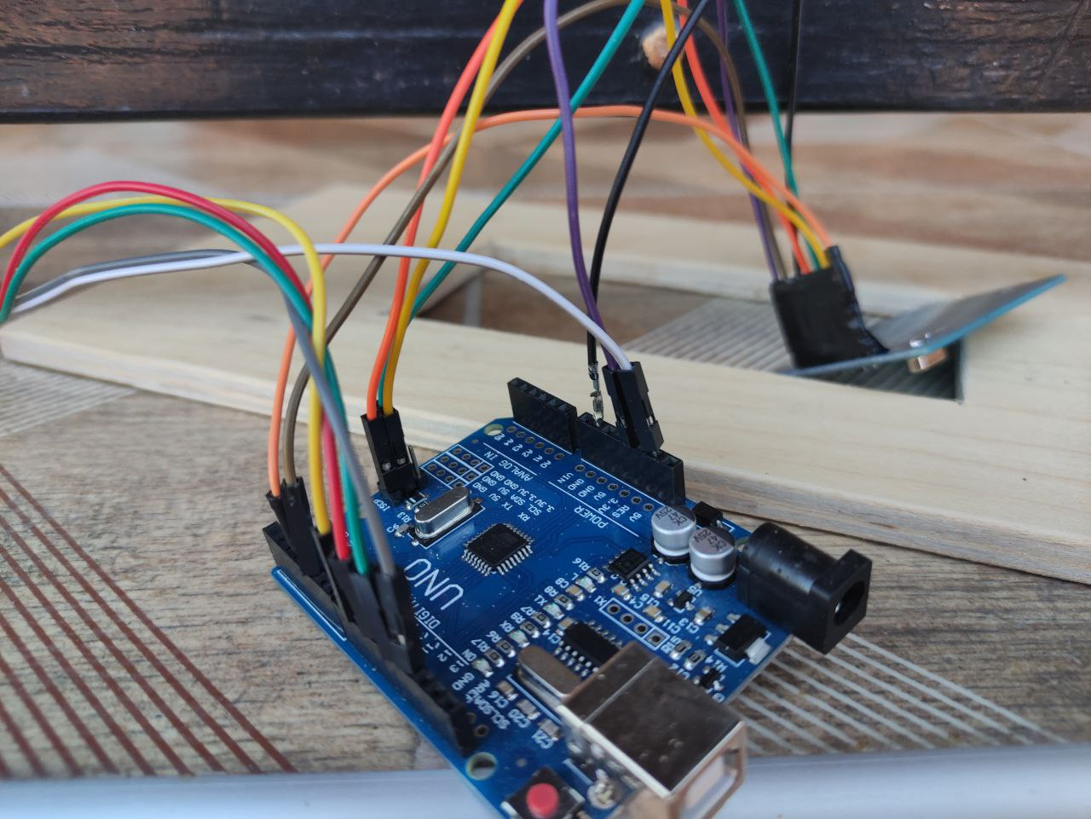
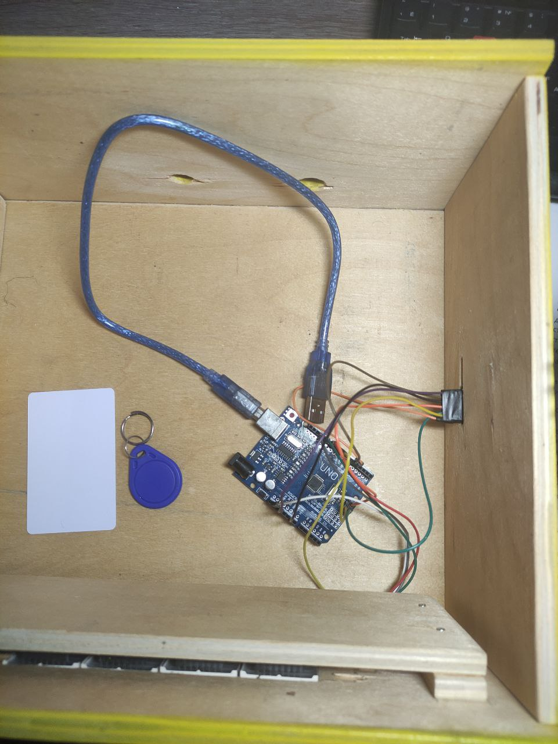
My project

Slide 8
Thank you for watching

